Slide 1


PERSONAL FINANCE EXPENSE ANALYZER
Track Spending • Predict Future • Protect Savings
Main Goal: Predict Spending, Prevent Overspending, Protect Savings
STUDENT NAME
Kedar Pophale B24AD1003
Sanchita Pathak B24AD1024
Om Dhakane B24AD1007
Spandan Wasnik B24AD1005
COURSE / DEPARTMENT
AIDS
COLLEGE
Marathwada Mitra Mandal’s College Of Engineering
Mentor
Dr. Dhanraj Dhotre
Notes:
1

Slide 2





THE CHALLENGE
The Problem
Silent Overspending
Fast-Moving Categories
Users record expenses but may not realize where they're overspending.
Spending on Dining, Shopping and Travel can increase quickly.
Too Late to React
Shrinking Savings
Budget problems are often discovered only after overspending has happened.
Current spending can quietly reduce planned savings.
Blind to What's Next
Users may not know how current spending affects upcoming or next month's expenses.
PROBLEM STATEMENT
How can we identify overspending early and show users how it can affect their future savings?
PERSONAL FINANCE EXPENSE ANALYZER
2
Notes:
2

Slide 3




OUR APPROACH
The Proposed Solution
The system lets users manually enter transactions, then runs them through a six-stage analysis pipeline:
1
2
3
4
5
6
Separate Expenses
Analyze Patterns
Predict Spending
Detect Overspending
Calculate Impact
Recommend Action
Fixed, recurring-variable & variable
Study category-wise spending
Forecast future spend per category
Flag when budgets are at risk
Translate overspend into savings loss
Suggest how to control spending
MAIN IDEA
Track Spending → Predict Future Spending → Detect Overspending → Show Savings Impact → Recommend Action
PERSONAL FINANCE EXPENSE ANALYZER
3
Notes:
3

Slide 4



SYSTEM DESIGN
How the System Works
1
2
3
4
5
Manual Transaction
Entry
Store Transaction
in Database
Expense
Categorization
Category-wise
Spending Analysis
Future Spending
Prediction
10
9
8
7
6
Display Alert on
Dashboard
Generate Personalized
Recommendation
Calculate Impact
on Savings
Detect Possible
Overspending
Compare Predicted vs
Budget
Continuous Update: Whenever the user adds, edits or deletes a transaction, the system updates the analysis automatically.
Risk-detection step
PERSONAL FINANCE EXPENSE ANALYZER
4
Notes:
4

Slide 5
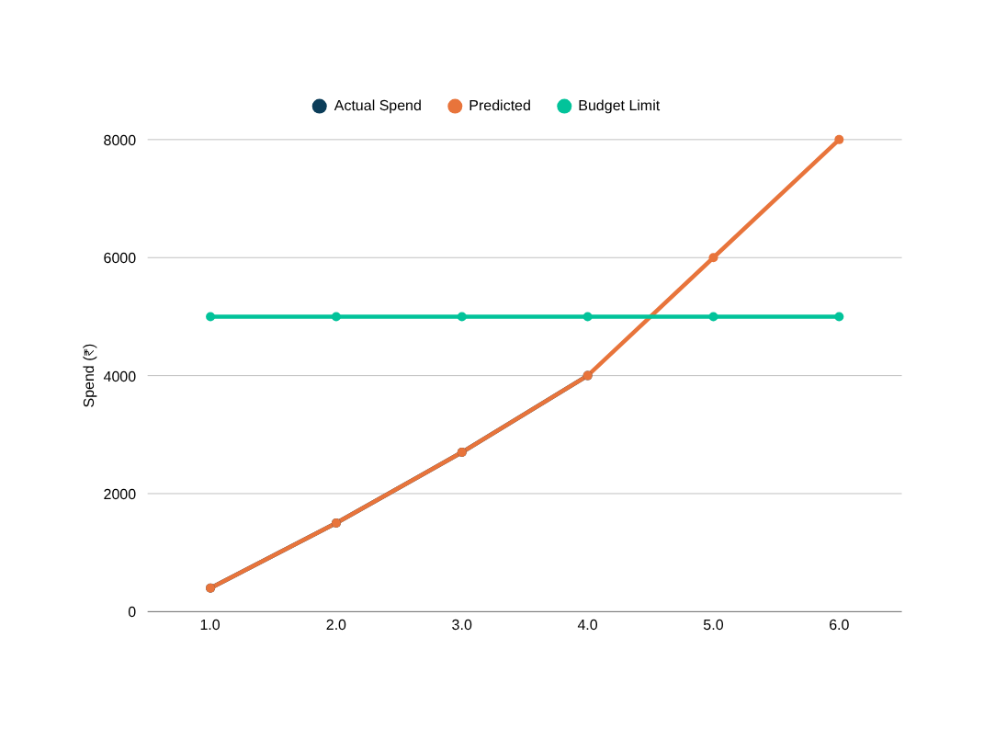
AI / ML ENGINE — PART 1
Future Spending Prediction
Spending Trajectory vs. Budget
Model: Linear Regression
Learns from the user's previous and current spending to project where a category will land by month-end.
Dining Budget
₹5,000
Spent in 10 Days
₹4,000
Predicted Month-End Spending ≈ ₹8,000
Expected Overspending
₹8,000 − ₹5,000 = ₹3,000
PERSONAL FINANCE EXPENSE ANALYZER
5
Notes:
5

Slide 6


AI / ML ENGINE — PART 2
Unusual Spending & Smart Explanation
Model: Isolation Forest
LLM Explanation Layer
Checks whether a transaction or spending pattern is unusual compared with the user's normal behavior.
Converts calculated results into a simple, friendly message the user actually understands.
New Transaction
₹4,000 → Unusual
Your Dining spending is high.
You've used 80% of your budget early in the month. Reducing Dining spending can help protect your savings.
Normal Dining
≈ ₹500
PERSONAL FINANCE EXPENSE ANALYZER
6
Notes:
6

Slide 7

WORKED EXAMPLE
Smart Financial Warning
User Situation
Impact on Savings
Recommendation
Dining Budget
₹5,000
Expected Overspending
₹8,000 − ₹5,000 = ₹3,000
You're spending faster than planned on Dining.
Normal Daily Target
₹167
Spent in 10 Days
₹4,000
Planned Savings
₹15,000
Your normal target is around ₹167/day. Try reducing Dining spending to around:
Budget Used
80%
₹115 – ₹120 / day
ML Prediction
Remaining Savings
₹12,000
to reduce the impact on savings.
Predicted Month-End Spending
₹8,000
₹15,000 − ₹3,000 = ₹12,000
KEY IDEA: Overspending → Lower Savings → Reduce Spending → Protect Savings
PERSONAL FINANCE EXPENSE ANALYZER
7
Notes:
7

Slide 8


ACADEMIC FOUNDATIONS
Course Mapping
DBMS
DSA
Statistics
OOPS
Store & retrieve financial data
Process transactions efficiently
Understand spending behavior
Organize & structure the application
  Transactions
  Budgets
  Categories
  Savings goals
  Search
  Sort
  Group transactions
  Category-wise totals
  Average & median
  Spending variation
  Trends
  Normal patterns
  Classes & Objects
  Encapsulation
  Inheritance
  Code Reusability
PERSONAL FINANCE EXPENSE ANALYZER
8
Notes:
8

Slide 9


IMPLEMENTATION
Technology Stack
Frontend
Backend
Database
HTML + CSS
Python + FastAPI
MySQL
ML
LLM
Python + Scikit-learn
LLM API
FINAL GOAL
Don't just show users where their money went — show them where their current spending could lead.
PERSONAL FINANCE EXPENSE ANALYZER
9
Notes:
9

Slide 10
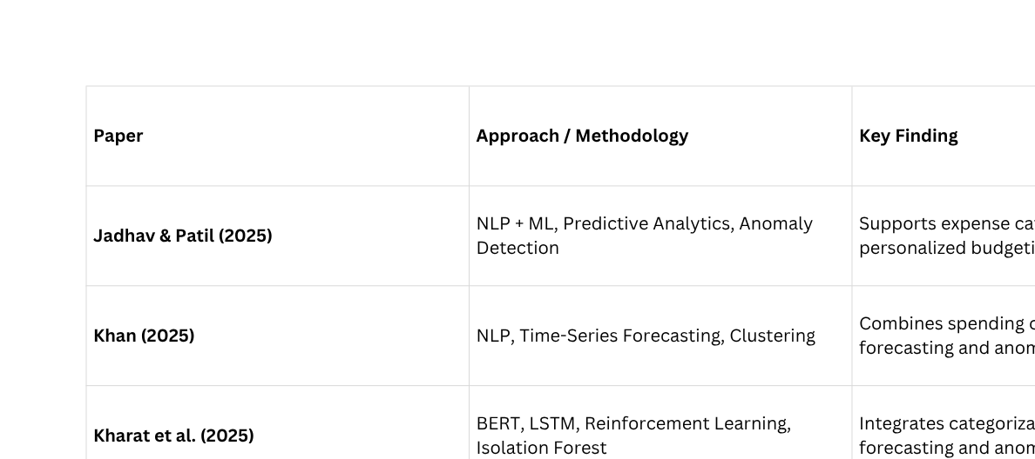
Survey, Gap & Proposed Framework
Literature Survey & Research Proposal
RESEARCH GAP
Existing research addresses categorization, forecasting, budgeting and anomaly detection, but there is scope for an integrated system that predicts overspending and estimates its potential impact on savings.
PROPOSED APPROACH
Transaction → Expense Type Classification → Spending Analysis → Future Prediction → Overspending Detection → Savings Impact → Recommendation
PERSONAL FINANCE EXPENSE ANALYZER
10

Slide 11
THANK YOU..........
Notes:
1

